Slide 1



Capgemini
CONSULTING. TECHNOLOGY. 0 UT SOURCING
People
matter.
results
count.
Fresher Learning Program
Teradata Popular OLAP Examples
Hyderabad, Date, Sreedevi.Ipparthy

Slide 2

Module Object
▪
To be familiar with popular OLAP functions.
▪
To be familiar with the PARTITION By concept.
▪
To
be
familiar
with
RANK()
,
ROW_NUMBER(),
QUALIFY functions.
Presentation Title | Date
Copyright © Capgemini 2015. All Rights Reserved 2

Slide 3
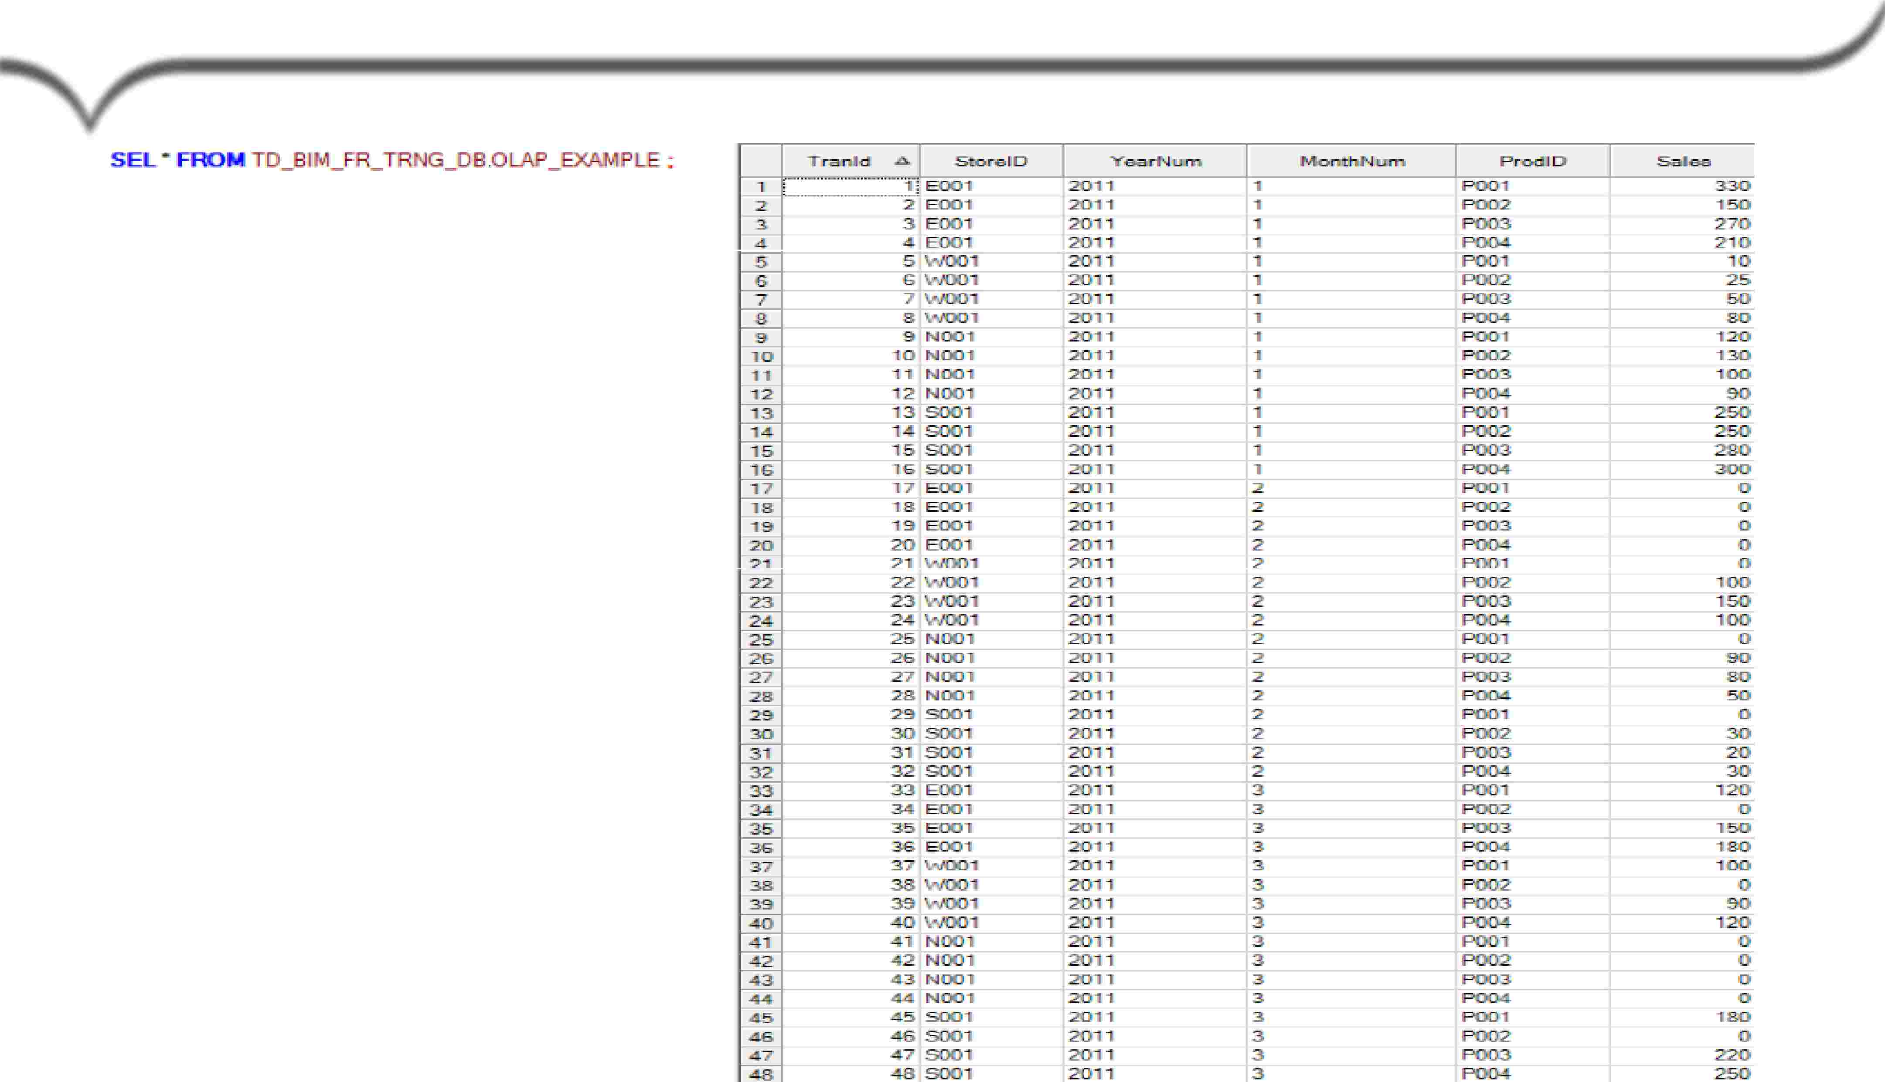
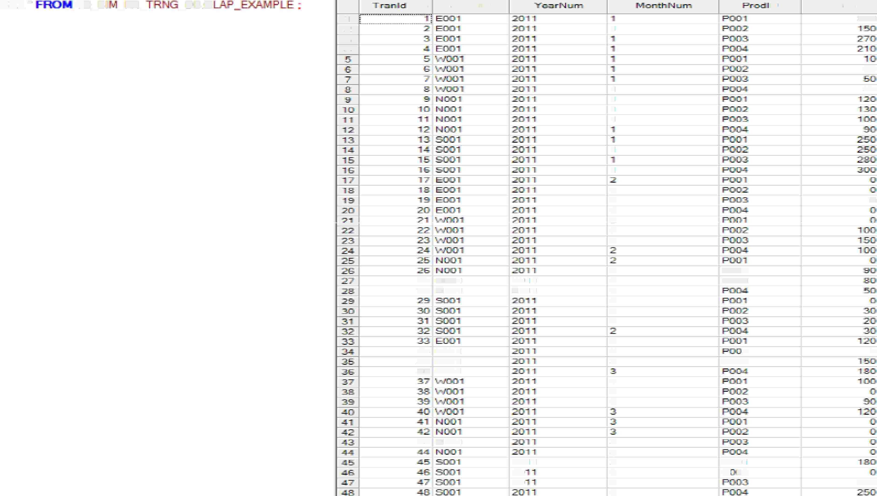

Example
Table “OLAP_EXAMPLE”
SEl..'"'
. TID_B.I
-^{FR_}
_DB.O
...ci..
Sto:JielD
[J
Sa.lea
11
2
.3
.d
1
330
25
1
1
1
1
so
1
1
.2
2
2
7
2
2
0
27
1)111001
2011
.2{)111
2
2
2
2
2
2
ROIJ2
ROOi3
.28 N001
34! BIJIOl
35 EOBl
36 E001
3
3
3
2
POl)\3
0
3
3
3
43
1)111001
3
3
3
3
3
3
2(l11
2:0
20
POCilr'I
H·o2
22D
Capgemmi
CON 5 ULT I NG. TECH NOL O G Y. 0 UT 5 0 UR CI NG
Presentation Title | Date
Copyright © Capgemini 2015. All Rights Reserved 3

Slide 4

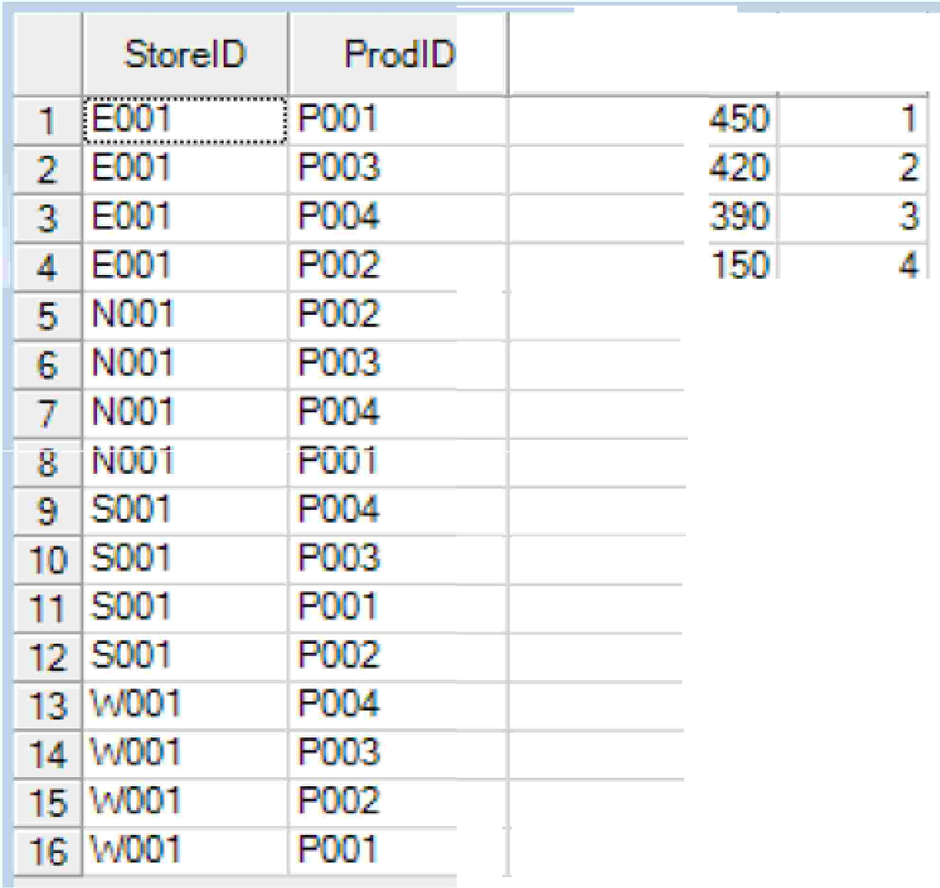






Usage of PARTITION
BY
to
derive
RANK
to
i . d 't - e RANIK
'for each p 01,_, uct; based
on the
· 1i th, n
sum sa e5 value �desc)
eac - S'tora •1 I
E5)S5 LES.
STORBID ORDER
PUE
SS
LES D:
·
- AS R .
•
I
Capgemmi
CON 5 ULT I NG. TECH NOL O G Y. 0 UT 5 0 UR CI NG
Presentation Title | Date
Copyright © Capgemini 2015. All Rights Reserved 4

Slide 5
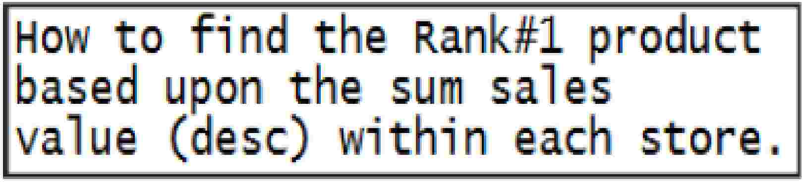
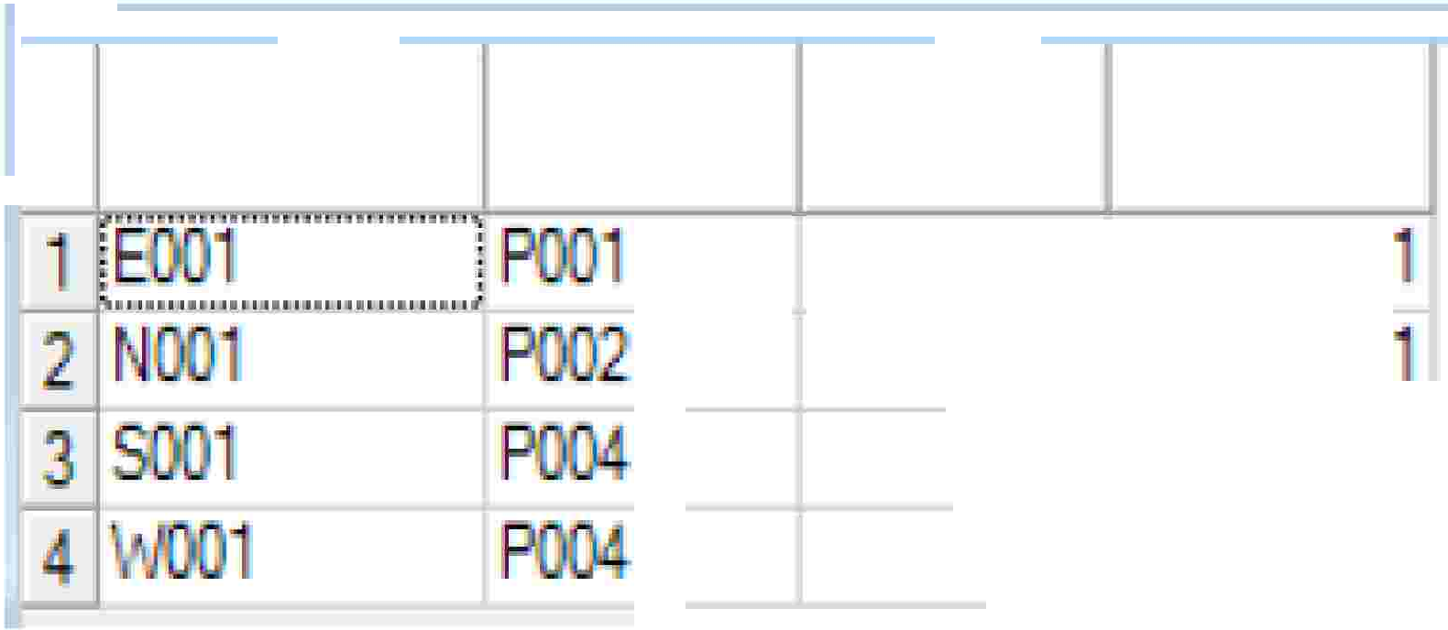



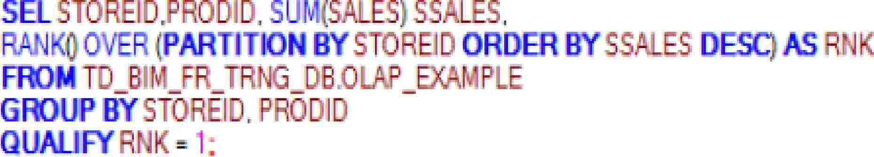

Usage
of
RANK
&
QUALIFY
Pr
. I
Capgemmi
CON 5 ULT I NG. TECH NOL O G Y. 0 UT 5 0 UR CI NG
Presentation Title | Date
Copyright © Capgemini 2015. All Rights Reserved 5

Slide 6
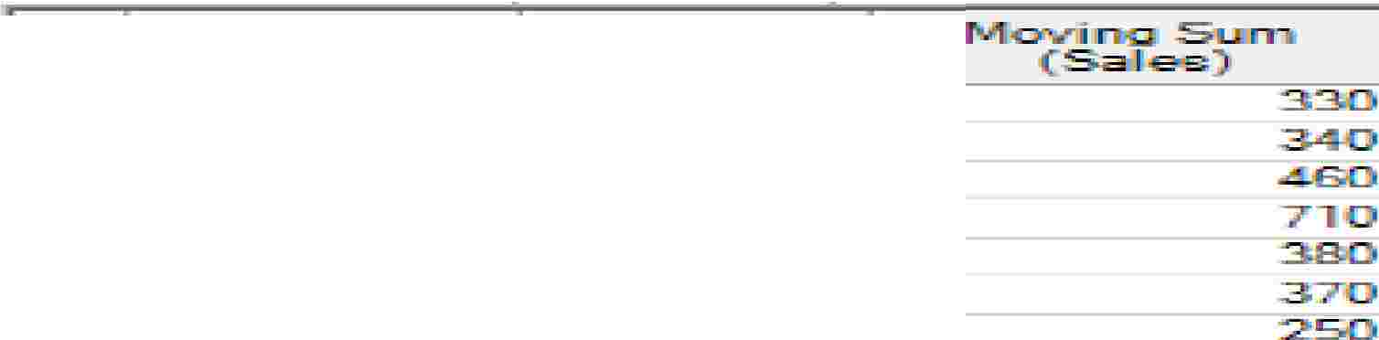


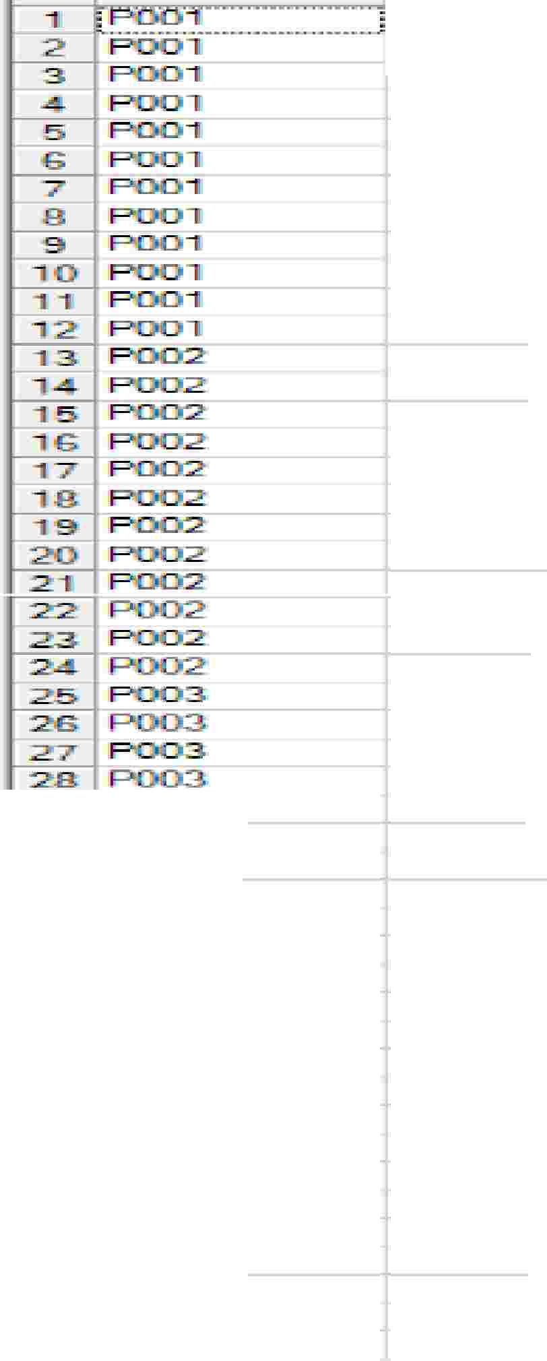






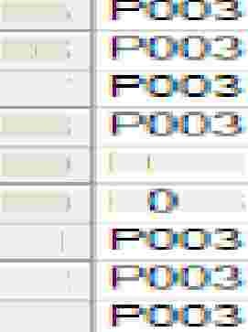

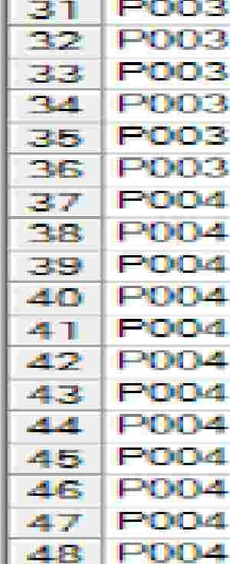






Usage of ROWS BETWEEN (PRECEDING-FOLLOWINGCURRENT ROW)
Ho to fi 1d the mo¥, g sum
for eac product i eluding
current ro and 3 ro s prideding.
R.-..:::x::IID
0
I!]!
·151rni
175
3i{),5
.!555
....
0
� 1 Poonm_ � !=.!=:_
sur (S. ES) OVER ( PAR I
OWS BETWEEN 3 P ECE I G
IFRO TiD _13 I 1.11_FR_TA G_D B .0 LA
3!(]11
0
0
0
0
270
5'0
.22:liJII
:2:2:li]i
2
30
ID
.25
26
27
28
29
3C1
3,
32
33
....
Pl:303.
p 03
280
0
....
90
P004
p
p[]!(Ja4.
P.:
p
p p p
p()i(W.
P.: p: p
22iO
-.1:0
.80
"90
Capgemmi
CON 5 ULT I NG. TECH NOL O G Y. 0 UT 5 0 UR CI NG
Presentation Title | Date
Copyright © Capgemini 2015. All Rights Reserved 6

Slide 7


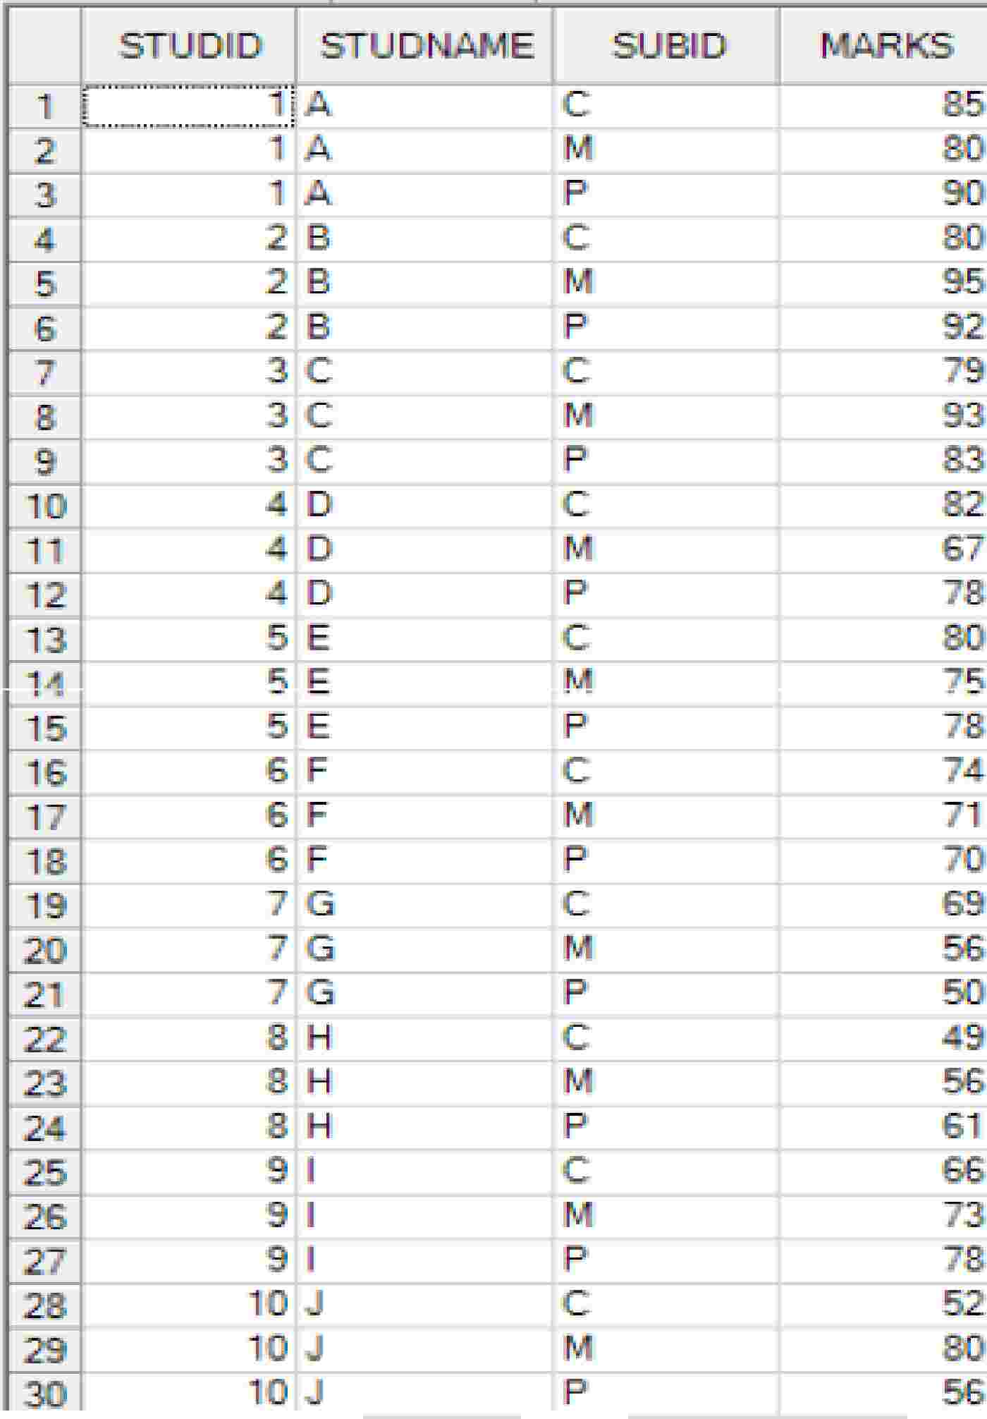

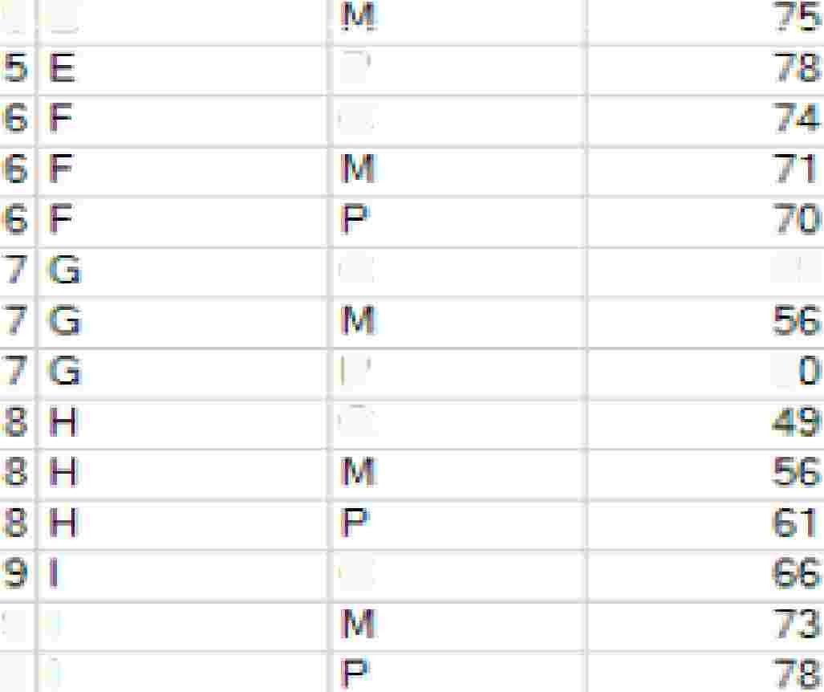

Example
Table
“OLAP_EXAMPLE_CLASS”
s
2
B
8
.95
'92
.91
'93
S3
3
3
3
IP
c
c
5
E
p
c
c
p
c
69
5
c
9
9
I
I
Capgemmi
CON 5 ULT I NG. TECH NOL O G Y. 0 UT 5 0 UR CI NG
Presentation Title | Date
Copyright © Capgemini 2015. All Rights Reserved 7

Slide 8
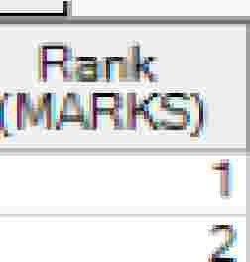
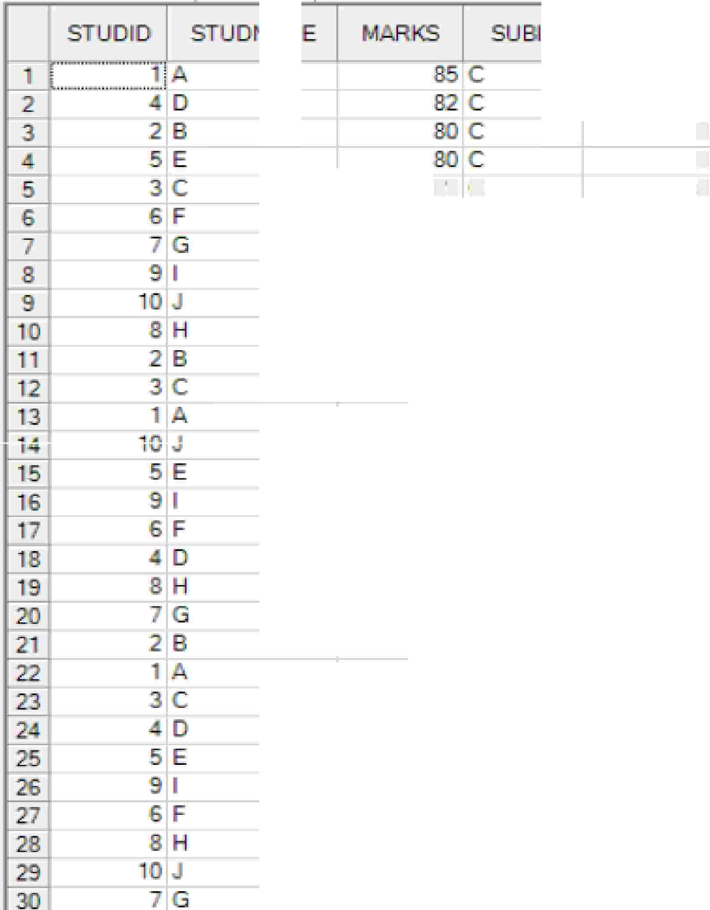












Usage
of
RANK
&
PARTITION
BY
Ho
to f'i nd t.nfi RA-· K 01-f
each s�ud� � on eac
3
3
5
sub-ect �ased on the,•
obt.a'i ed nar-ks..,
79 C
7
C
1
'9
2
'9
.9
.....
p
11
Capgemmi
CON 5 ULT I NG. TECH NOL O G Y. 0 UT 5 0 UR CI NG
Presentation Title | Date
Copyright © Capgemini 2015. All Rights Reserved 8

Slide 9
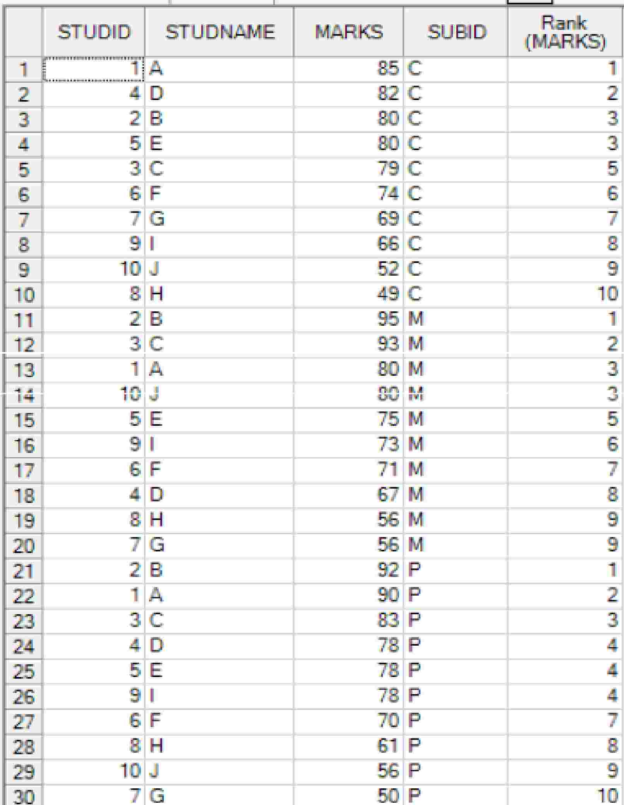

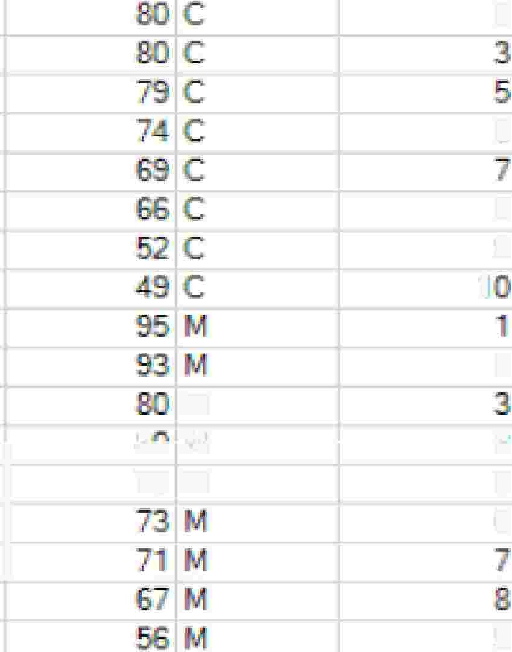



Usage
of
RANK
&
PARTITION
BY
Ho
to ·; nd the
RA- -K of
each stude ton
eac
3
subjQct ase on thai
ob i a.� ed air ks...
6
8
,^{'9}
2
n,
M
I
I.Ji
1
..J
5
16
U'U ... ,
7.5 M
TD_8l1
'9
Capgemmi
CON 5 ULT I NG. TECH NOL O G Y. 0 UT 5 0 UR CI NG
Presentation Title | Date
Copyright © Capgemini 2015. All Rights Reserved 9

Slide 10
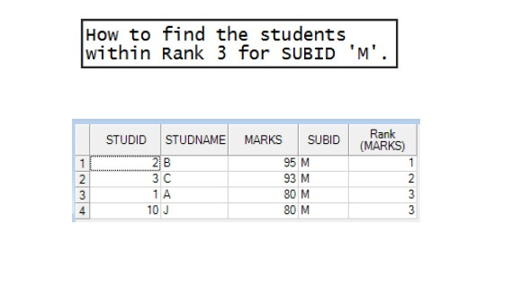
Usage
of
RANK
&
PARTITION
BY
Presentation Title | Date
Copyright © Capgemini 2015. All Rights Reserved 10

Slide 11
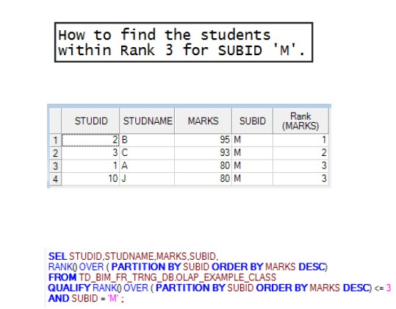
Usage
of
RANK
,
QUALIFY &
PARTITION
BY
Presentation Title | Date
Copyright © Capgemini 2015. All Rights Reserved 11

Slide 12
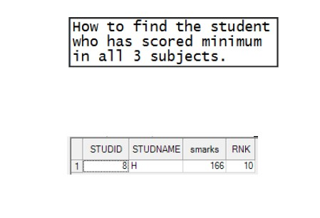
Usage
of
RANK
,
QUALIFY &
PARTITION
BY
Presentation Title | Date
Copyright © Capgemini 2015. All Rights Reserved 12

Slide 13
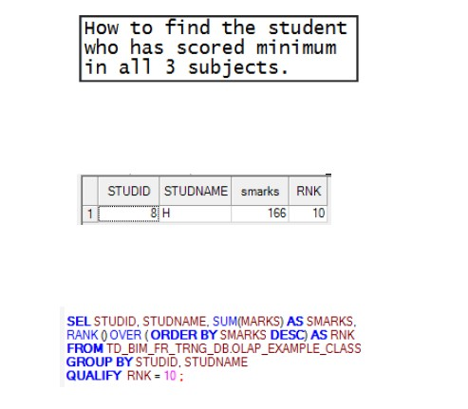
Usage
of
RANK
,
QUALIFY &
PARTITION
BY
Presentation Title | Date
Copyright © Capgemini 2015. All Rights Reserved 13

Slide 14
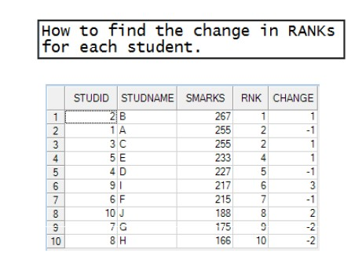
Usage
of
RANK
,
QUALIFY &
PARTITION
BY
Presentation Title | Date
Copyright © Capgemini 2015. All Rights Reserved 14

Slide 15
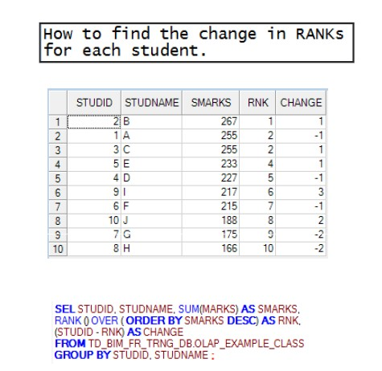
Usage
of
RANK
,
QUALIFY &
PARTITION
BY
Presentation Title | Date
Copyright © Capgemini 2015. All Rights Reserved 15

Slide 16
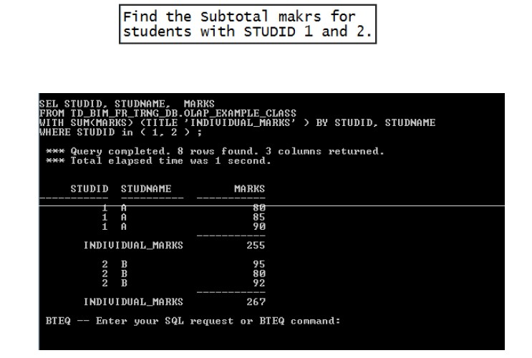
Usage
of
RANK
&
PARTITION
BY
Presentation Title | Date
Copyright © Capgemini 2015. All Rights Reserved 16

Slide 17




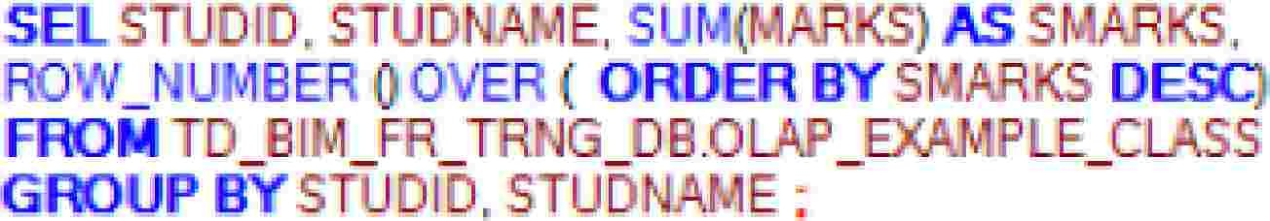

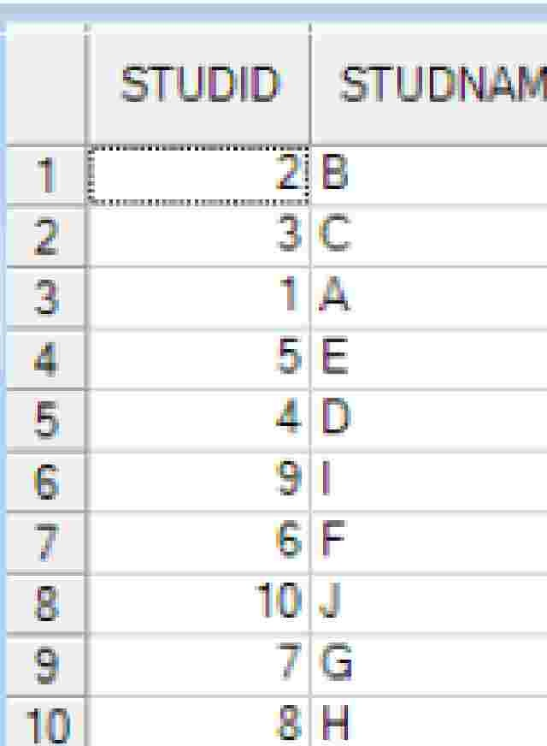
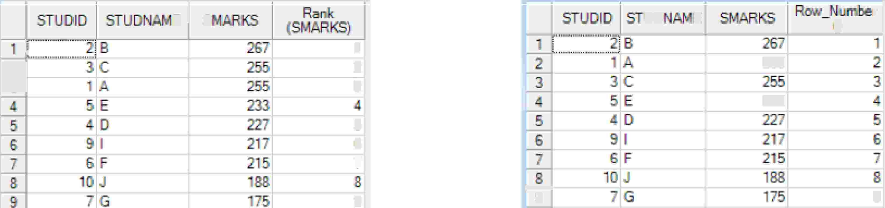
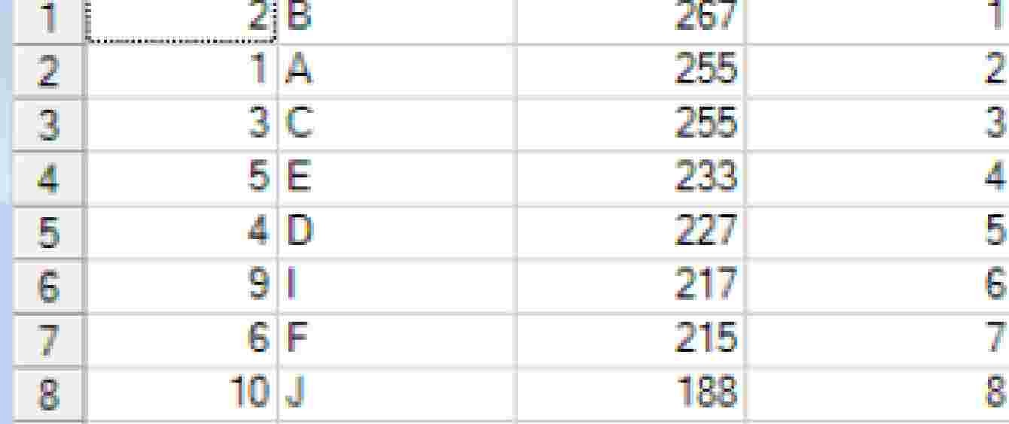
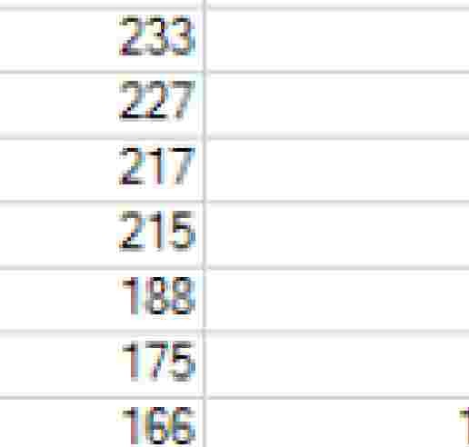

Usage
of
RANK
&
PARTITION
BY
_c
5
Ej
s
uo-
- -
E
0
r I
I=
1
2
.2
255
�
233
5
6
7
1------t
s
9
'9
Capgemmi
CON 5 ULT I NG. TECH NOL O G Y. 0 UT 5 0 UR CI NG
Presentation Title | Date
Copyright © Capgemini 2015. All Rights Reserved 17

Slide 18
Q
&
A
Presentation Title | Date
Copyright © Capgemini 2015. All Rights Reserved 18

Slide 19
QUIZ
▪
1. Which two partitioning expressions are available to both single-
level and multi-level partitioned tables? (Choose two.)
A. MODULO_N partitioning
B. CASE_N partitioning
C. RANGE_N partitioning
D. Direct partitioning on a numeric column
Option B,C
▪
▪
▪
▪
▪
2. What are two reasons a customer would choose table
partitioning? (Choose two.)
A. to improve performance of full table scans
B. to reduce the I/O for range constrained queries
C. for better distribution of data between the AMPs
D. for the ability to archive specific partitions in a table
▪
▪
▪
▪
Option B,D
Presentation Title | Date
Copyright © Capgemini 2015. All Rights Reserved 19

Slide 20
QUIZ
▪
3. On which two table types can a multi-level partitioned primary
index (MLPPI) be created? (Choose two.)
A. Volatile tables
B. Derived tables
C. Global temporary tables
D. Compressed join indexes
Option A,C
▪
▪
▪
▪
▪
4. Which two table types support multi-level
primary indexes (MLPPI)? (Choose two.)
A. Base tables
B. Compressed Join Indexes
C. Global temporary Trace tables
D. Non-compressed join indexes
partitioned
▪
▪
▪
▪
Option A,D
Presentation Title | Date
Copyright © Capgemini 2015. All Rights Reserved 20

Slide 21
Contact
information
Insert contact picture
Name
Last Name Title/Role name.lastname@capgemini.com
Insert contact picture
Name
Last Name Title/Role name.lastname@capgemini.com
Capgemini Office (Optional)
Address Line 1
Address Line 2
Address Line 3
Capgemini Office (Optional)
Address Line 1
Address Line 2
Address Line 3
Insert contact picture
Name
Last Name Title/Role name.lastname@capgemini.com
Insert contact picture
Name
Last Name Title/Role name.lastname@capgemini.com
Capgemini Office (Optional)
Address Line 1
Address Line 2
Address Line 3
Capgemini Office (Optional)
Address Line 1
Address Line 2
Address Line 3
Presentation Title | Date
Copyright © Capgemini 2015. All Rights Reserved 21

Slide 22




About Capgemini
With almost 145,000 people in over 40 countries, Capgemini is one of the world's foremost providers of consulting, technology and outsourcing services. The Group reported 2014 global revenues of EUR 10.573 billion.
Together with its clients, Capgemini creates and delivers business and technology solutions that fit their needs and drive the results they want. A deeply multicultural organization, Capgemini has developed its own way of working, the Collaborative Business Ex perienc e™ , and draws on Rightshore®,
its worldwide delivery model.
Learn more about us at www.capgemini.com.
www.capgemini.com
The information contained in this presentation is proprietary.
Copyright © 2015 Capgemini. All rights reserved. Rightshore® is a trademark belonging to Capgemini.

